Slide 1
Marketing Prediction Software for Banks Advanced Software Engineering
Rithwick M14626629

Slide 2
Index
Abstract
Introduction
Motivation and Background
Problem statement and Objectives
Approach and Working methodology
Evaluations and Tests
Results
Conclusion

Slide 3
Abstract
Marketing refers to activities undertaken by a company to promote the buying or selling of a product or service. By examining the importance of marketing in banking sector, identifying the customers who are more likely to respond to new product offers is an important issue in direct marketing.
All bank marketing campaigns are dependent on customer’s huge electronic data. The size of these data sources is impossible for a human analyst to come up with interesting information that will help in the decision-making process. So, we definitely need a software to make this process easy. Machine Learning and Data mining models are completely helpful in bringing out the best performance of these campaigns.

Slide 4
Introduction
Mass marketing technique and Direct marketing technique are 2 techniques that target clients and customers to offer them new products and bank offers through different mediums and platforms.
Mass marketing is a technique in which single communication message will be sent to all customers and Direct marketing is a technique where the selected customers will be contacted directly through: personal contact, telephone cellular, and email.
Response rate of customer is less in mass marketing compared to direct marketing.

Slide 5
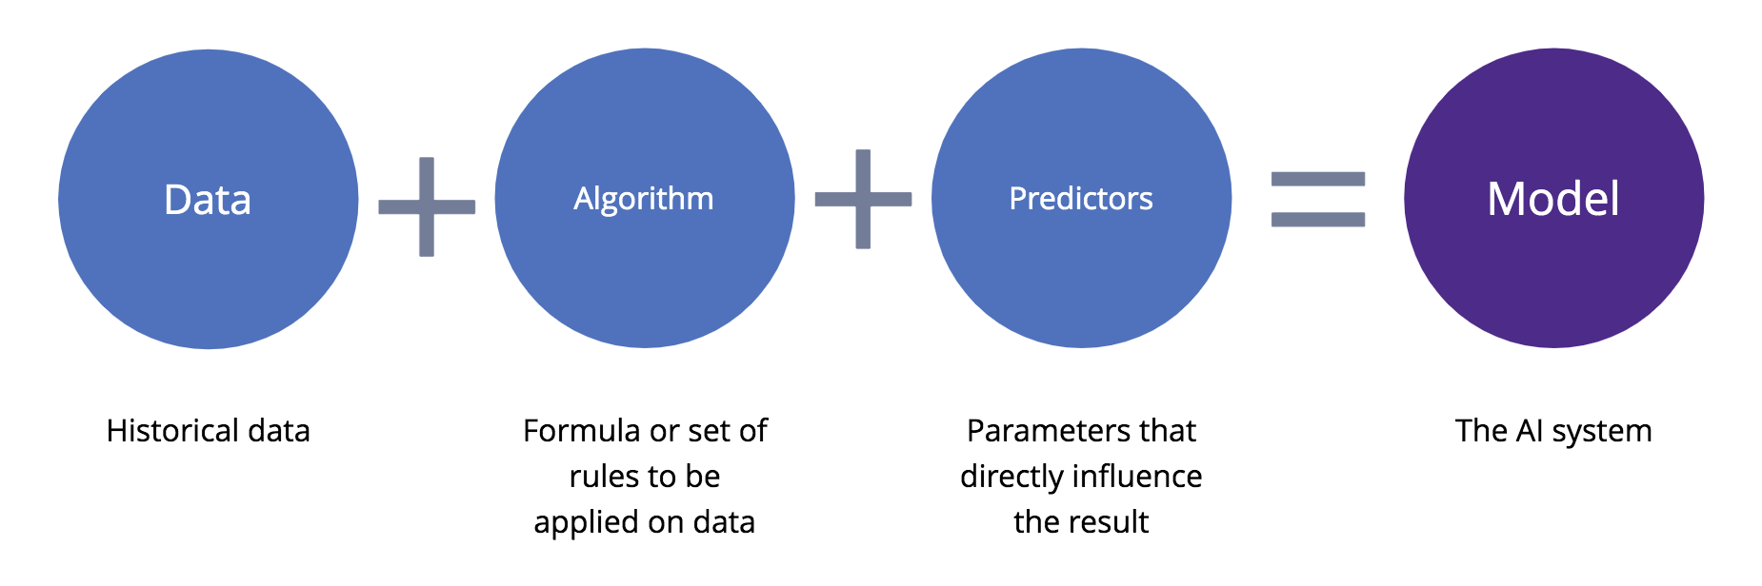
Introduction
In banks, there will be huge data that records all the information related to customers including personal and loan details. This data can be used to create clear relationship, interesting patterns and connection with the customers.

Slide 6
Motivation and Background
As said, mass marketing is facing a lot of logistic failures, publicity failure, money wastage and in return there is negativity growing in people on the respected company due to these irrelevant messages and emails. To find a proper way of marketing and effective communication is the main motivation to select and develop this project.
Before researching about the similar kind of project, I have done some basic study to understand better about the direct marketing. Nowadays many financial services, banks and investment services are giving priority for direct marketing over mass marketing because of its effectiveness and they would like to know about the customer’s choices and want to explain about product offers or banking offers effectively.
Historically, the name and identification of the term “direct marketing” suggested first time in 1967 by Lester Wunderman who is considered to be the father of direct marketing.

Slide 7
Problem Statement and Objectives
The Main agenda is to increase the campaign effectiveness by identifying the main characteristics that affect success (the deposit subscribed by the client) with the software based on a handful of ML algorithms.
The following are the objectives of this project:
To predict whether the client (customer) will subscribe to a term deposit or bank offers.
To improvise the marketing campaign of bank by analyzing the past collected data and recommending right customers.
To give valuable inputs and suggestions to marketing team based on the customer details.

Slide 8
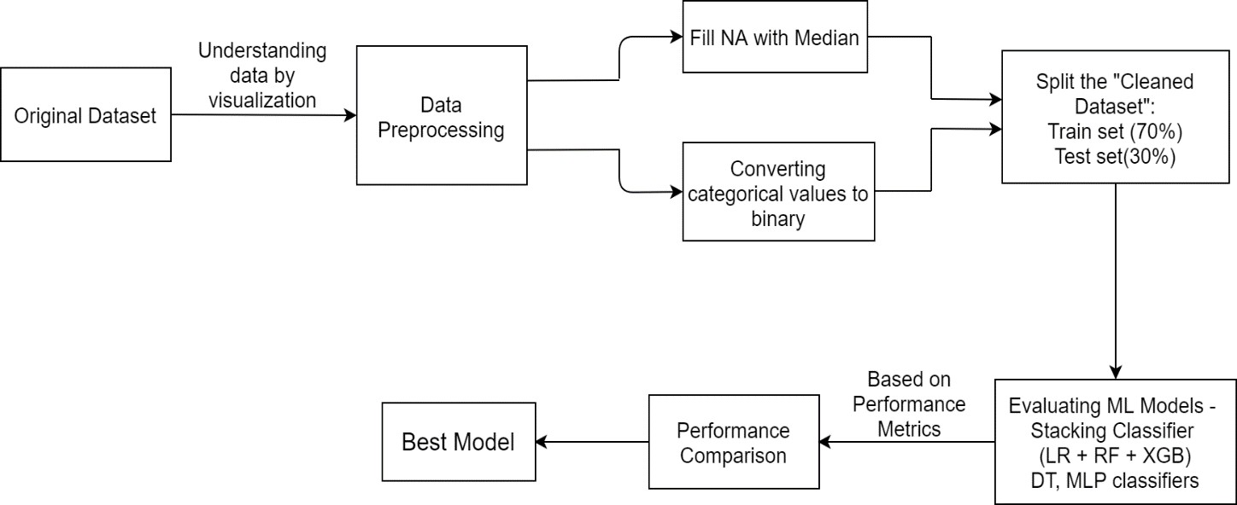
Approach

Slide 9
Working Methodology
The flow of the project goes this way:
Understanding the dataset
Data Visualization
Data preprocessing
Evaluate ML Algorithms - Building models
Performance comparison and choosing the Best model
Developing an interface (front end)

Slide 10
Understanding the Dataset
Considering the Portuguese bank data as dataset to this project which is available on kaggle.
No of instances : 41,000+
No of features : 20+ class variables
Attributes : Age, job, loan, no. of campaigns, marital status etc.
To check if the model is good, splitting the data into training and validation/test sets to check the accuracy of the best model. For this, the given data will be split into two, 70% of which will be used to train models and 30% will be hold back as a test set.

Slide 11

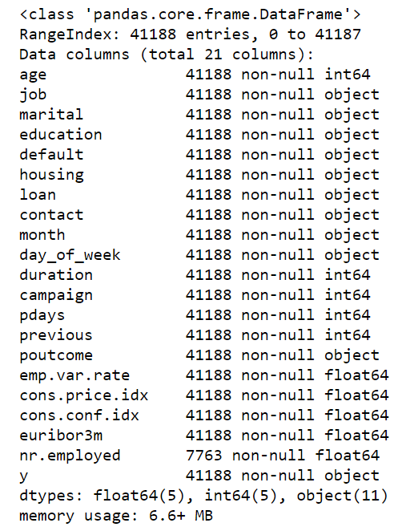

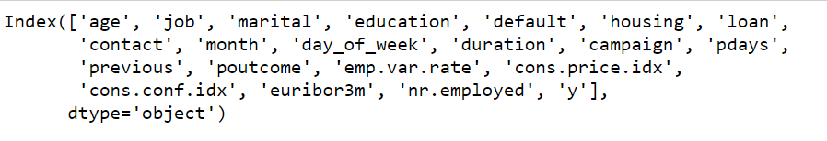
Understanding the Dataset
Description of data:

Slide 12
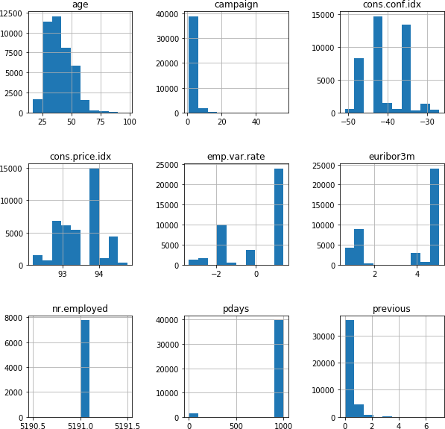
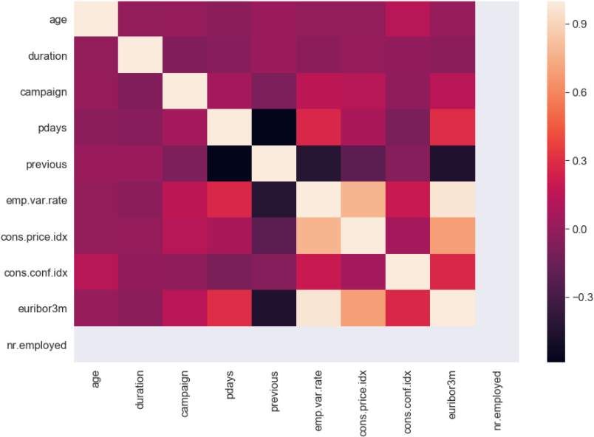
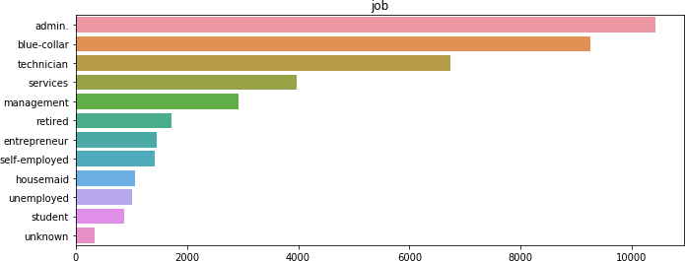
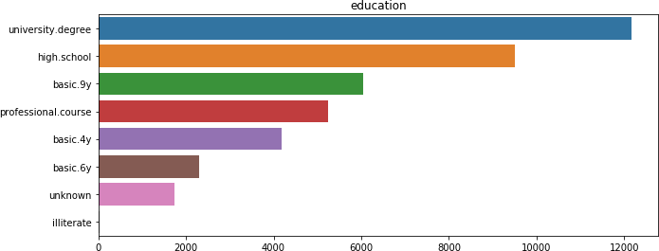
Data Visualization
Histograms: Heat map: Bar Graphs: (job, education)
9(

Slide 13
Data Preprocessing
Converting Categorical values into Binary values.
Addition of new columns. 21 features -> 55 features.
Next step is to find the no. of missing values in each column.
Filling missing values using Median statistic.
The column ‘nr.employed’ has too many missing values, so dropping it.

Slide 14

Evaluation – ML Algorithms
Divided the data (both features and corresponding labels) into training and test sets. Split training and validation into 70% and 30%.
Now applying different ML algorithms on the test/validation dataset to predict the target column values by training the model using train dataset.
They are: Logistic Regression, Decision Tree Classifier, Random Forest Classifier, XGBoost Classifier, MLP classifier.
In addition to these, created a new model – Stacking Classifier which will the combination of best 3 accuracy produced algorithms.

Slide 15
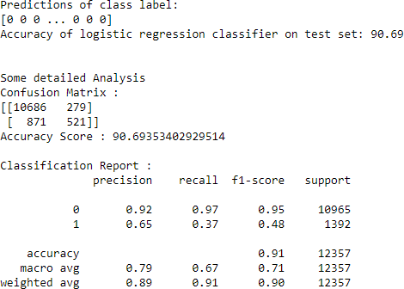
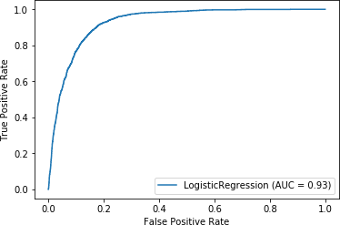
Evaluation – ML Algorithms
Logistic Regression: The key idea is, it uses a logistic function to model a binary dependent variable.

Slide 16
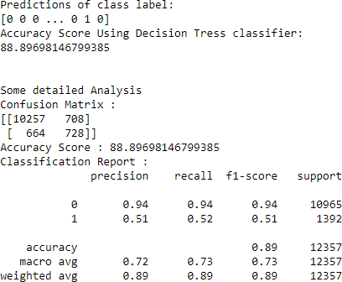
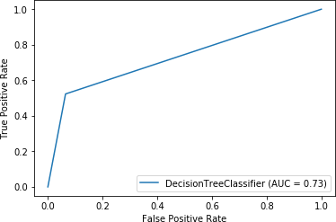
Evaluation – ML Algorithms
Decision Tree Classifier: It creates a tree using independent variables which will be given as input (training set) and based on Gini index. The two main entities of this algorithm are decision nodes, where the data is split and the leaves, where we get outcome.

Slide 17
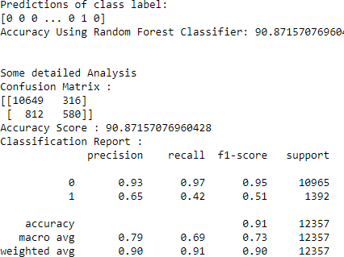
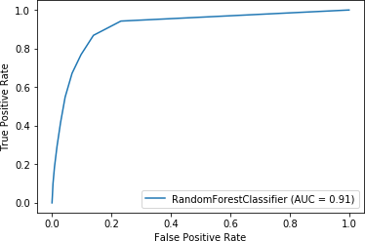
Evaluation – ML Algorithms
Random Forest Classifier: The main advantage is, it will be useful to avoid over-fitting issue by considering the average/mean of each decision tree. The count of decision trees depends on n_estimators’ parameter.

Slide 18
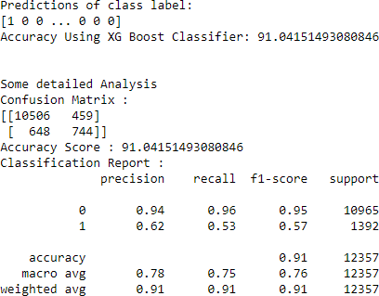
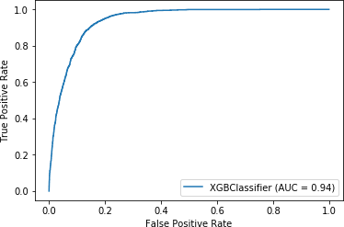
Evaluation – ML Algorithms
XG-Booster Classifier: This is boosting algorithm which is used to boost the performance of the model. It also follows the concept of decision trees.

Slide 19
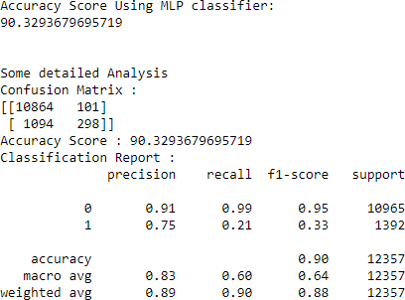
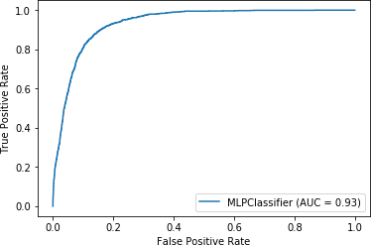
Evaluation – ML Algorithms
MLP Classifier: It is comprised of one or more layers of neurons. Data is passed to the input layer, there can be one or more hidden layers available, and predictions are made on the output layer.

Slide 20
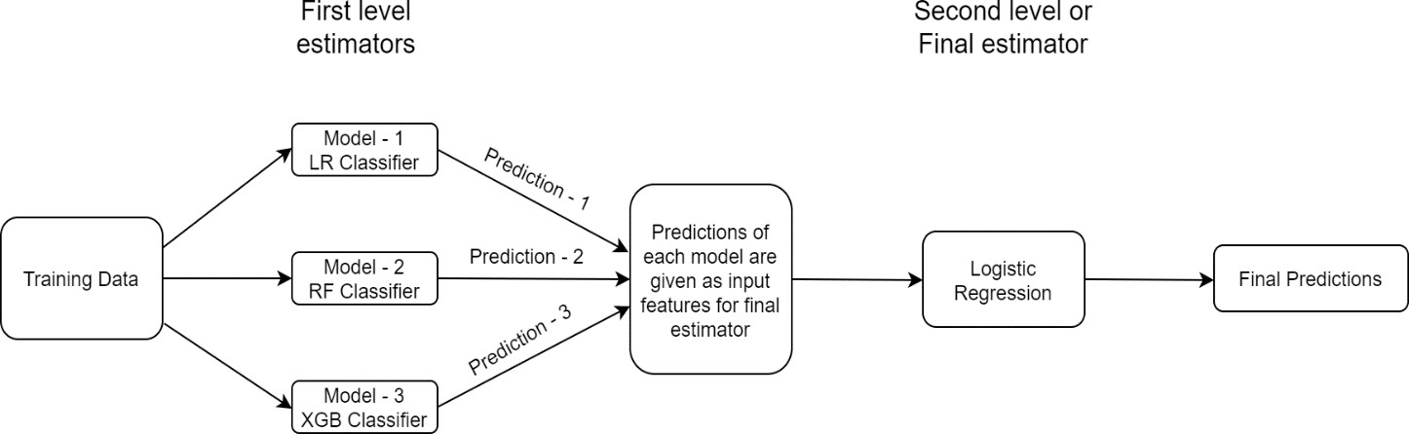
Proposed Model – Stacking Classifier
This is the proposed model for this project. It is an ensemble classifier where output of multiple classifiers is passed as an input for final estimator / meta classifier. After seeing the performance of all algorithms, Logistic regression, Random forest and XG-Boost are top performing classifiers for dataset. Therefore, created a “NEW MODEL” using these three algorithms.

Slide 21
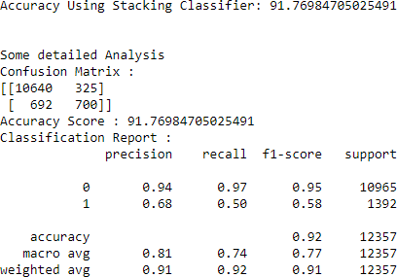
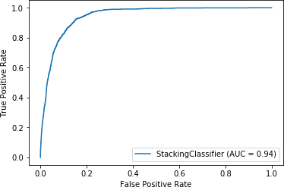
Evaluation – Stacking Classifier
In this case, the first level estimators are Logistic regression, Random forest and XG-Boost classifiers. From all these, the predictions will be produced individually and will be passed to second level estimator or final estimator or meta classifier which is logistic regression. After applying this, we will get the final result.

Slide 22
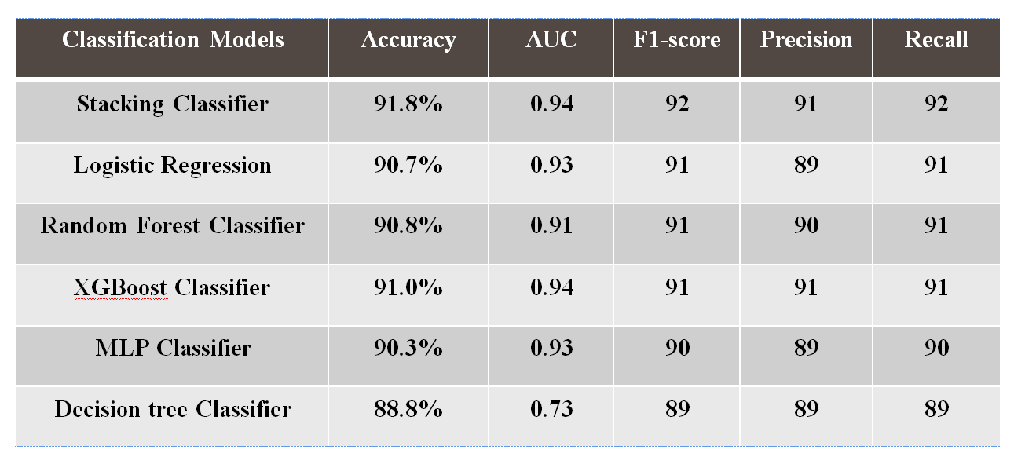
Results
The performance metrics (Accuracy, AUC, F1-score, Precision, Recall scores) of all the applied algorithms on the dataset are given below.

Slide 23
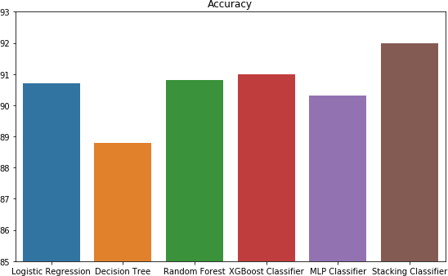
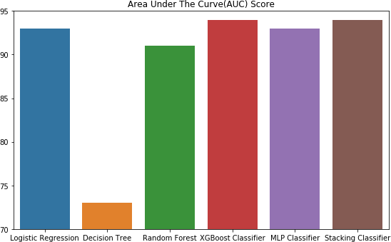
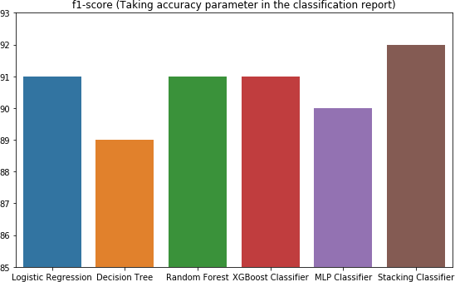
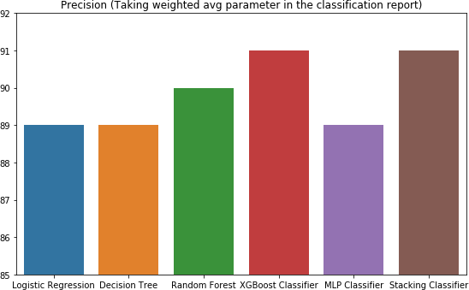

Results – Bar Plots for metric results

Slide 24
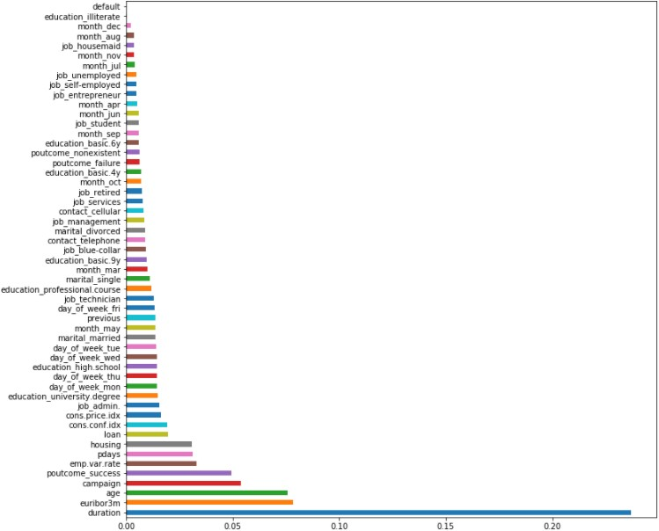
Results – Feature Importance

Slide 25
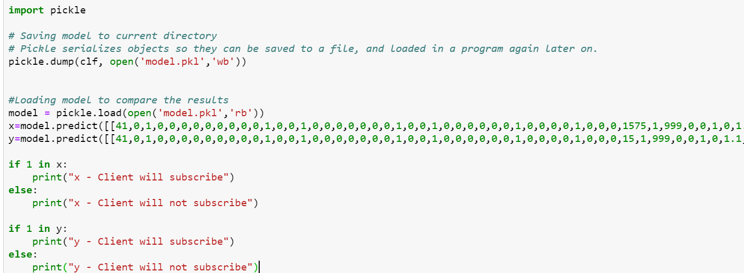
Interface – Web Application
Converting the resultant model using pickle library
Install flask library locally.
Now dumped the code for web app.

Slide 26
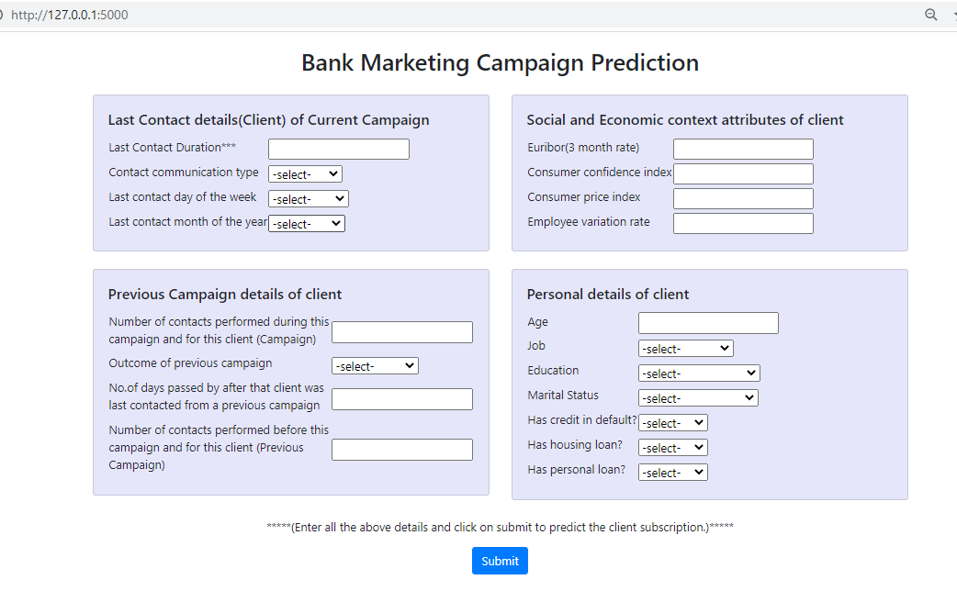
Interface Snippet

Slide 27
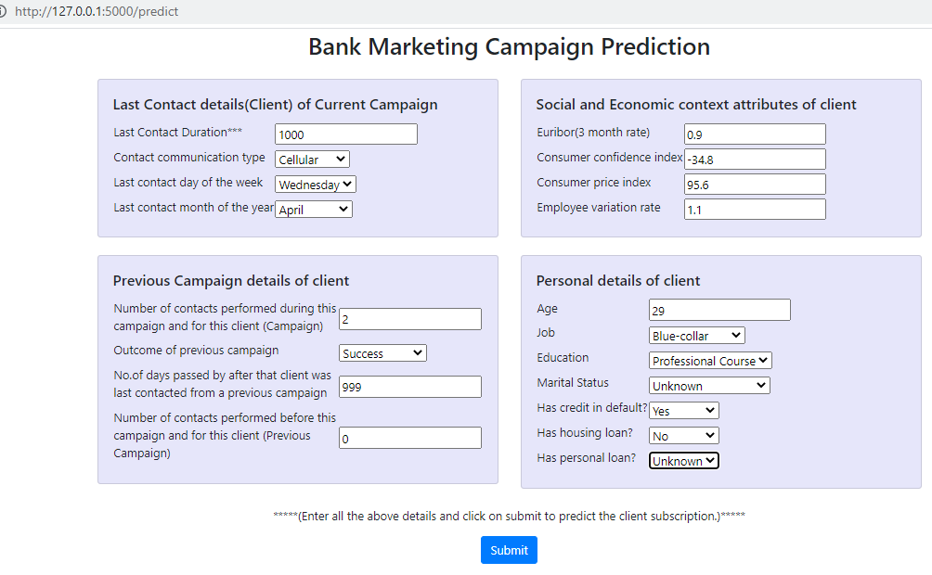
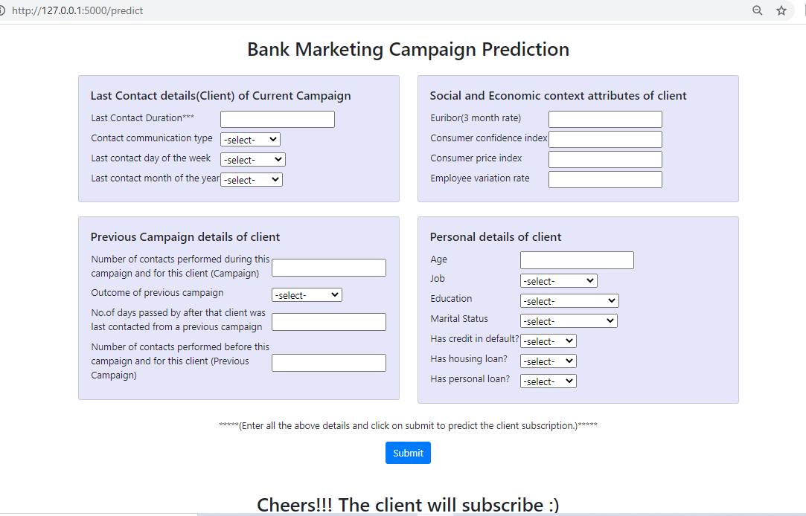
Test Case 1

Slide 28
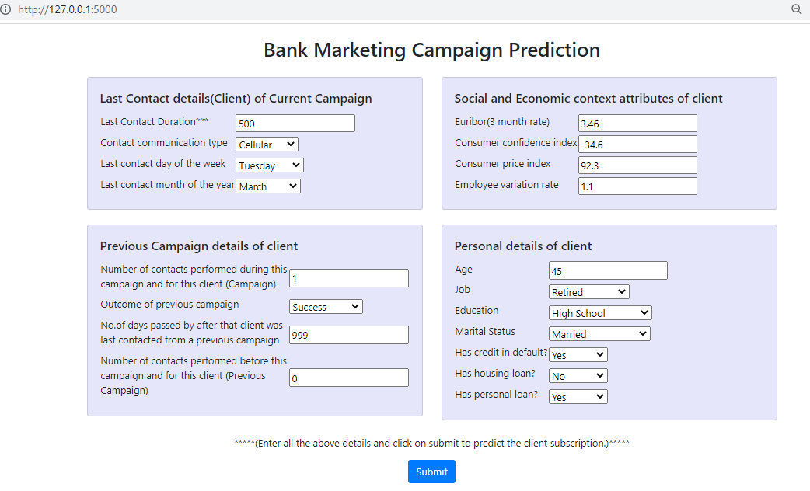
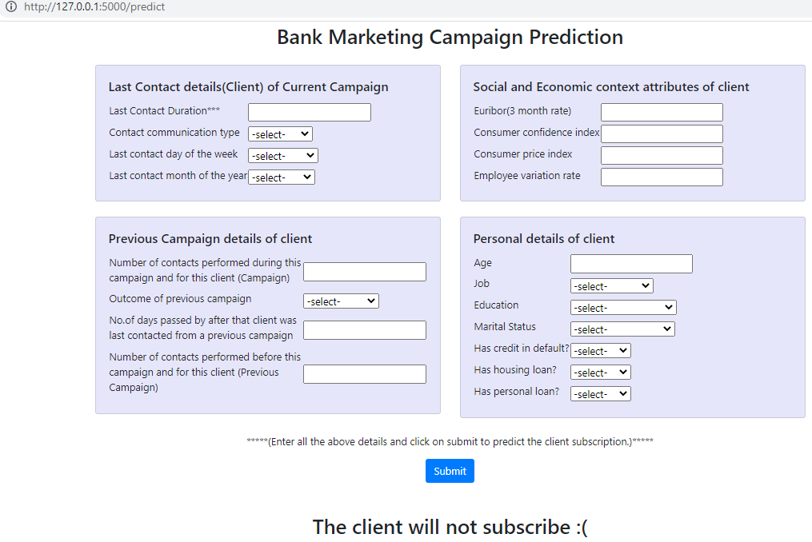
Test Case 2

Slide 29
Conclusion
From the above results, the best out of sample model performance was obtained for the Stacking Classifier (Logistic Regression + Random Forest + XG-Boost Classifier) with nearly 92% accuracy.
From this project, we learned how banks can improve their marketing campaigns by focusing their efforts on certain prime-grade clients.
Also, how they can recognize market conditions which are favorable to increase client subscription for the fixed-term products they are offering.

Slide 30
THANK YOU

